Slide 1
Using Sensors to Bridge the Gap between Real Places and their Web-based Representation
Myriam Leggieri, Christian von der Weth, John Breslin
Myriam Leggieri
Internet of Things Unit (UIoT)
myriam.leggieri@insight-centre.org
20th March 2015, ISSNIP2015

Slide 2
Outline
The Problem
Gap between Web and Real Places
Gap between Web and Sensor Web
Our Approach: G-Sensing
Frontend Architecture
Backend Architecture
Evaluation
Deployment
Coverage
Performance
Conclusions and Future Work
Tuesday, 26 November 2013

Slide 3
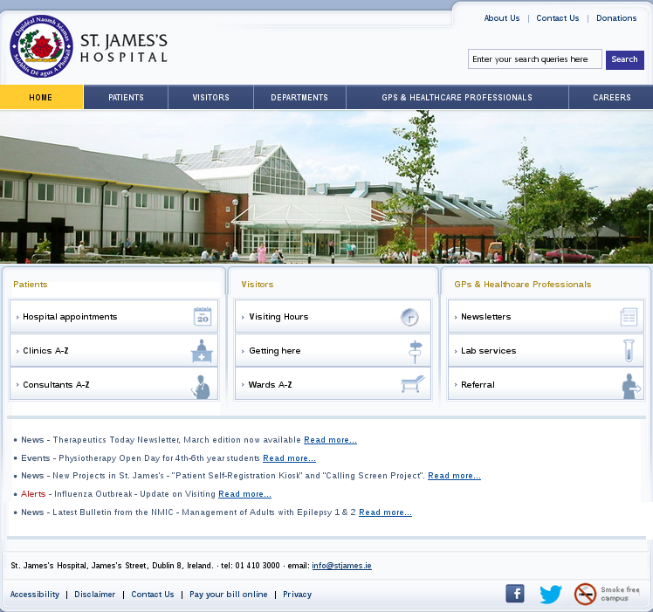
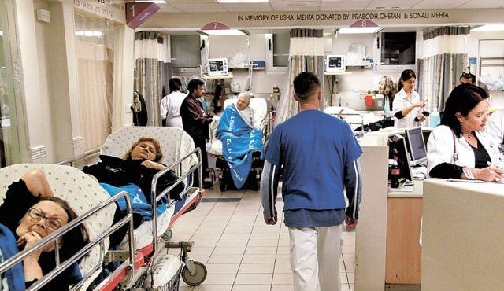


Between Web and Real Places

Slide 4


Slide 5
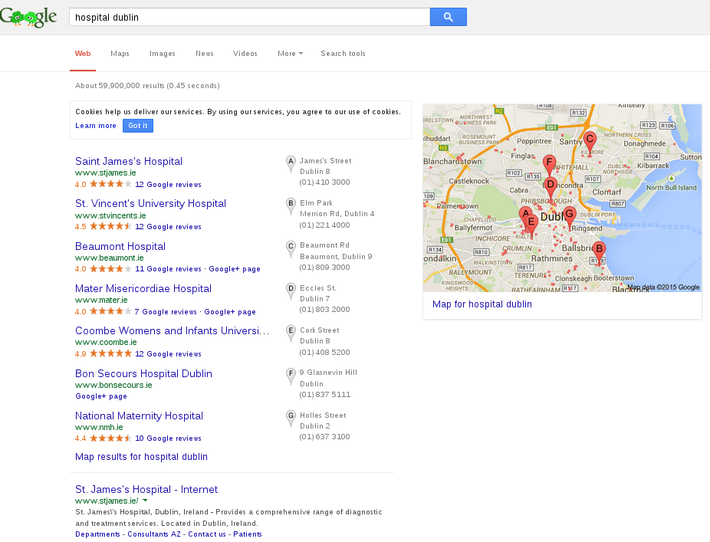

Slide 7
?

Slide 8
Sensors provide real-world live data
But
What?
Where?
How?

Slide 9
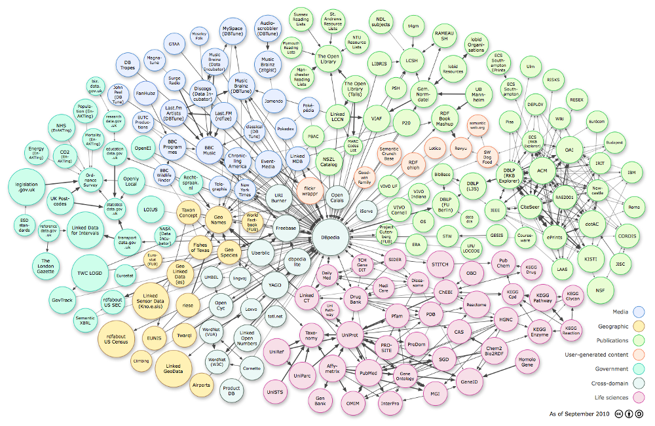

Short-lived Data
Cost
Long-lived Data

Slide 10
G-Sensing
Seamless integration of live sensor data into a user’s normal browsing experience
Browser add-on
collects live sensor data from the backend
injects them into Google search result pages
G-Sensing -enabled data source Requirements
expose SPARQL endpoint to query the data
provide semantically annotated sensor data
register on DataHub with its sensor tag metadata
= LD4S

Slide 11
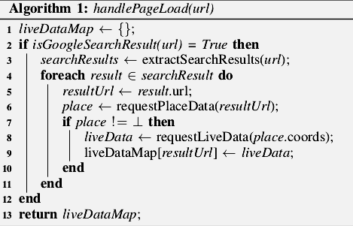
G-Sensing
Discovery of data sources
Extract search results referring to physical places
Live data fetching
Result dictionary update

Slide 12
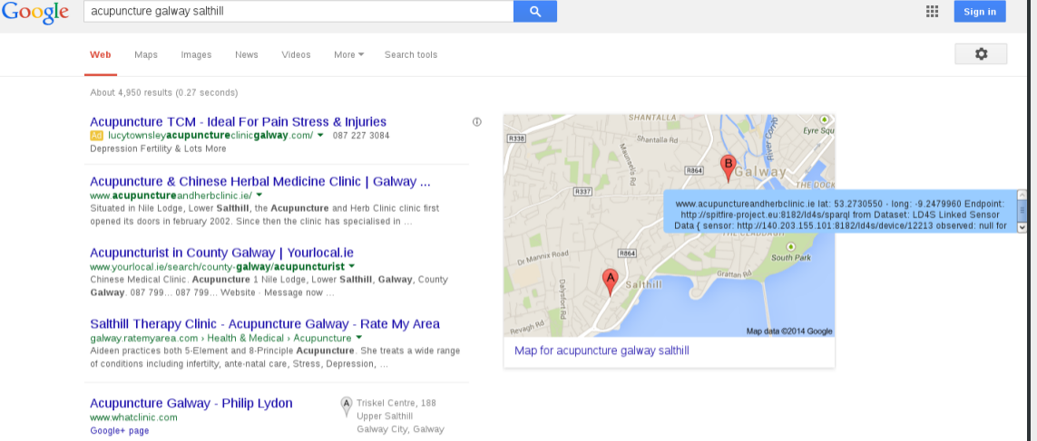
G-Sensing Frontend

Slide 13
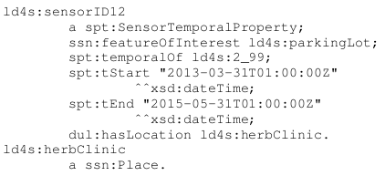
G-Sensing Backend
Specification-based sensor representation, storage and retrieval
Resource Description Framework (RDF)
(semi-)structured data mixed, exposed and shared across data sources
Ontology reuse principle
OWL to support reasoning over concepts
Linked Data principles
HTTP URLs
returning proper RDF description of the concept they represent
with RDF links to external resources
SPARQL to query RDF graphs
in the form of subgraphs, URIs, blank nodes or literals
No Ambiguity + Cross-dataset querying

Slide 14
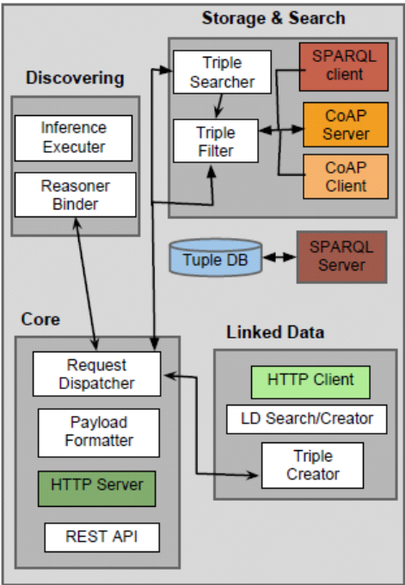
G-Sensing Backend
LD4S
JSON Web-service
automated annotation and linking for sensors
alternative custom link creation
domain and/or context-related criteria )to search for linkable resources
RDF predicate used to express the linking criteria
e.g., spt:sameTime, spt:sameSpace
relying on Sindice search engine API
RESTful API + GUI
SPARQL endpoint published on DataHub

Slide 15
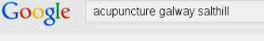
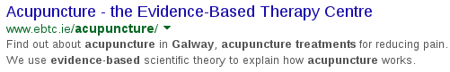
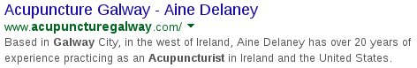
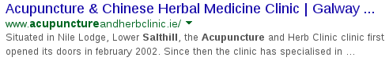
Evaluation - Deployment
30 sensors
Clinic
Clinic
1Km
PUT <JSON sensor metadata>
DataHub
LD4S
Google Places
Clinic
3.692 locations
1.455 (39.4%) have a website
G-Sensing

Slide 16
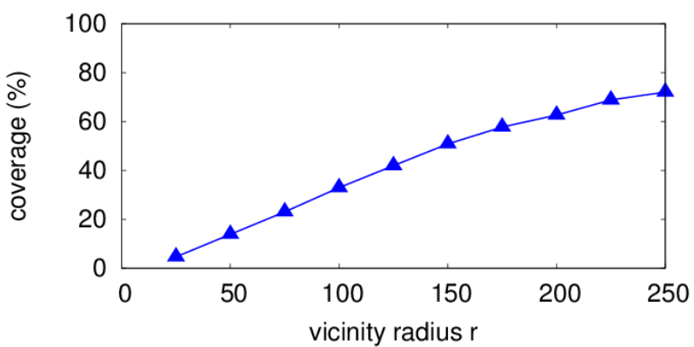
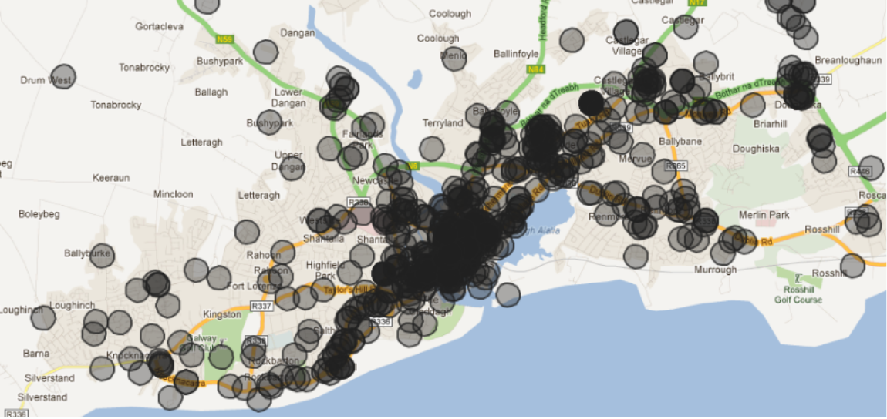
Evaluation - Coverage
Added value of our approach for integrating live data into physical locations' websites: distribution of physical locations' websites
How much of the area defined by the virtual locations overlaps with the city of Galway
within radius r=150m
Coverage percentage as we vary the vicinity radius

Slide 17
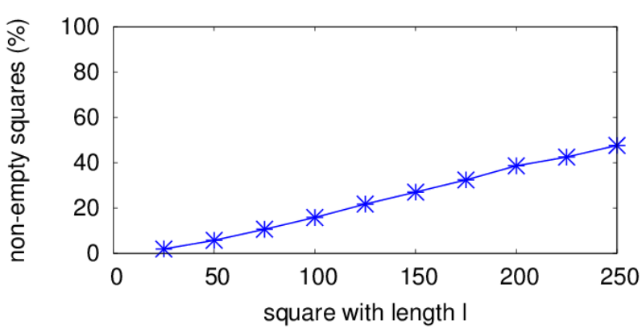
Evaluation - Coverage
We divided the areas of Galway divided into squares with different side lengths l
We counted the number of virtual locations within each square.

Slide 18
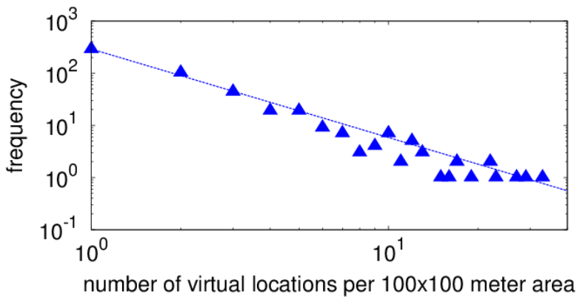
Evaluation - Coverage
Distribution of non-empty squares for l = 100m
# virtual locations per square and their respective frequency shows a power-law relationship
while most squares only contain a small set of locations, a few squares contain a very large number of locations
(e.g., city centres, business parks).

Slide 19
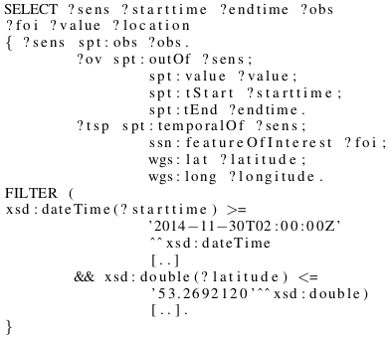
Evaluation - Performance
G-Sensing does not impede on a user's browsing experience
Bandwidth Overhead
Google search result page: ~145 KB
After enabling G-Sensing: ~175 KB (~20% increase)
At browser start-up: query to DataHub for data source discovery: 3 ms
20 sensor datasets discovered
3 sensor datasets have an open license + expose a SPARQL endpoint
1 sensor dataset’s SPARQL endpoint was accessible (LD4S): 246 ms
Response Time

Slide 20
Conclusion
Added value of G-Sensing
Websites about or referring to real-world locations are a common phenomenon in urban areas;
The performance of G-Sensing does not impede on a user’s browsing experience
Current Status of Sensor Data Sources
Limited availability of sensor datasets that are both open and public
Some of the SPARQL endpoints for such open and public datasets were inaccessible
Beyond search result pages
Our add-on-based approach can allow us to inject sensor information into any website

Slide 21
Future Work
Extended linkage
extend these connections by injecting sensor information into other Web pages that also refer to such venues, e.g., Tripadvisor
explore which types of connections are meaningful in a given application context and how such connections can be established
Example: latest webcam feeds showing a location that is mentioned in a news article displayed next to the article
User-centric live data representation
the G-Sensing output relevancy for an end user depends on the user’s current interests and on the type (and low level location) of sensor data displayed
recommender system that decides whether to display or not the retrieved sensor data according to a prediction of their current relevancy for the user

Slide 22



Thanks!
Myriam Leggieri - myriam.leggieri@insight-centre.org
Christian von Der Weth - vonderweth@nus.edu.sg
John Breslin - john.breslin@insight-centre.org

